Slide 1
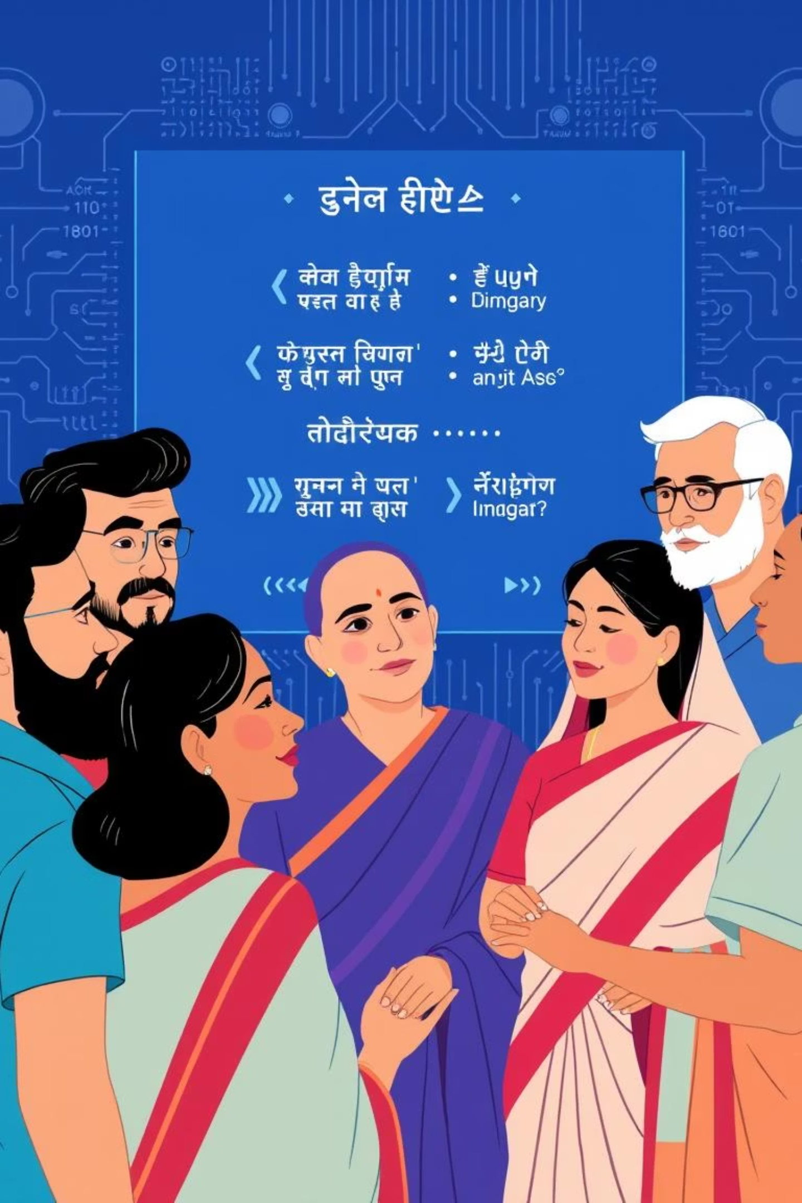

Community-Driven Speech Translation for Low-Resource Indian Languages Using AI
Team:
22071A3230
23075A3203
23075A3204
23075A3205
Under the Guidance of:
Dr. R Vasavi
Senior Assistant Professor
Computer Science and Engineering & CSBS
VNR Vignana Jyothi Institute of Engineering and Technology

Slide 2

ABSTRACT
Millions of speakers of local and tribal languages remain excluded from digital services due to a lack of language support in modern technologies. This initiative developed a web-based speech-to-language translation platform using artificial intelligence and community-driven validation. The system accepts spoken or uploaded audio in native languages and delivers real-time, culturally appropriate translations. It integrates AI-based speech recognition for low-resource languages and incorporates native speaker feedback to refine accuracy. A Cultural Context Engine ensures translations preserve both literal and intended meanings, fostering inclusive, respectful, and reliable communication.

Slide 3
INTRODUCTION
Digital Exclusion
High-Resource Bias
Local and tribal languages often lack adequate support in modern tech platforms, leading to the digital exclusion of millions of native speakers.
Most existing AI language systems disproportionately focus on high-resource languages, overlooking the unique linguistic needs of smaller communities.
Cultural Oversight
Inclusive Technology
Cultural sensitivity and contextual nuances are frequently ignored in current translation models, leading to inaccurate or inappropriate renditions.
There is a pressing need for inclusive, community-aware language technology that respects linguistic diversity and cultural heritage.

Slide 4




RESEARCH GAPS
1
Low-Resource Support
2
Contextual Accuracy
3
Community Participation
4
Dialectal Adaptation
Existing research and commercial systems exhibit significant limitations in supporting low-resource and tribal languages. Key challenges include inadequate accuracy, a pervasive lack of cultural context, minimal community involvement in dataset creation, and limited adaptability to diverse dialects or unique speech formats prevalent in these communities. These gaps hinder effective communication and digital inclusion.

Slide 5
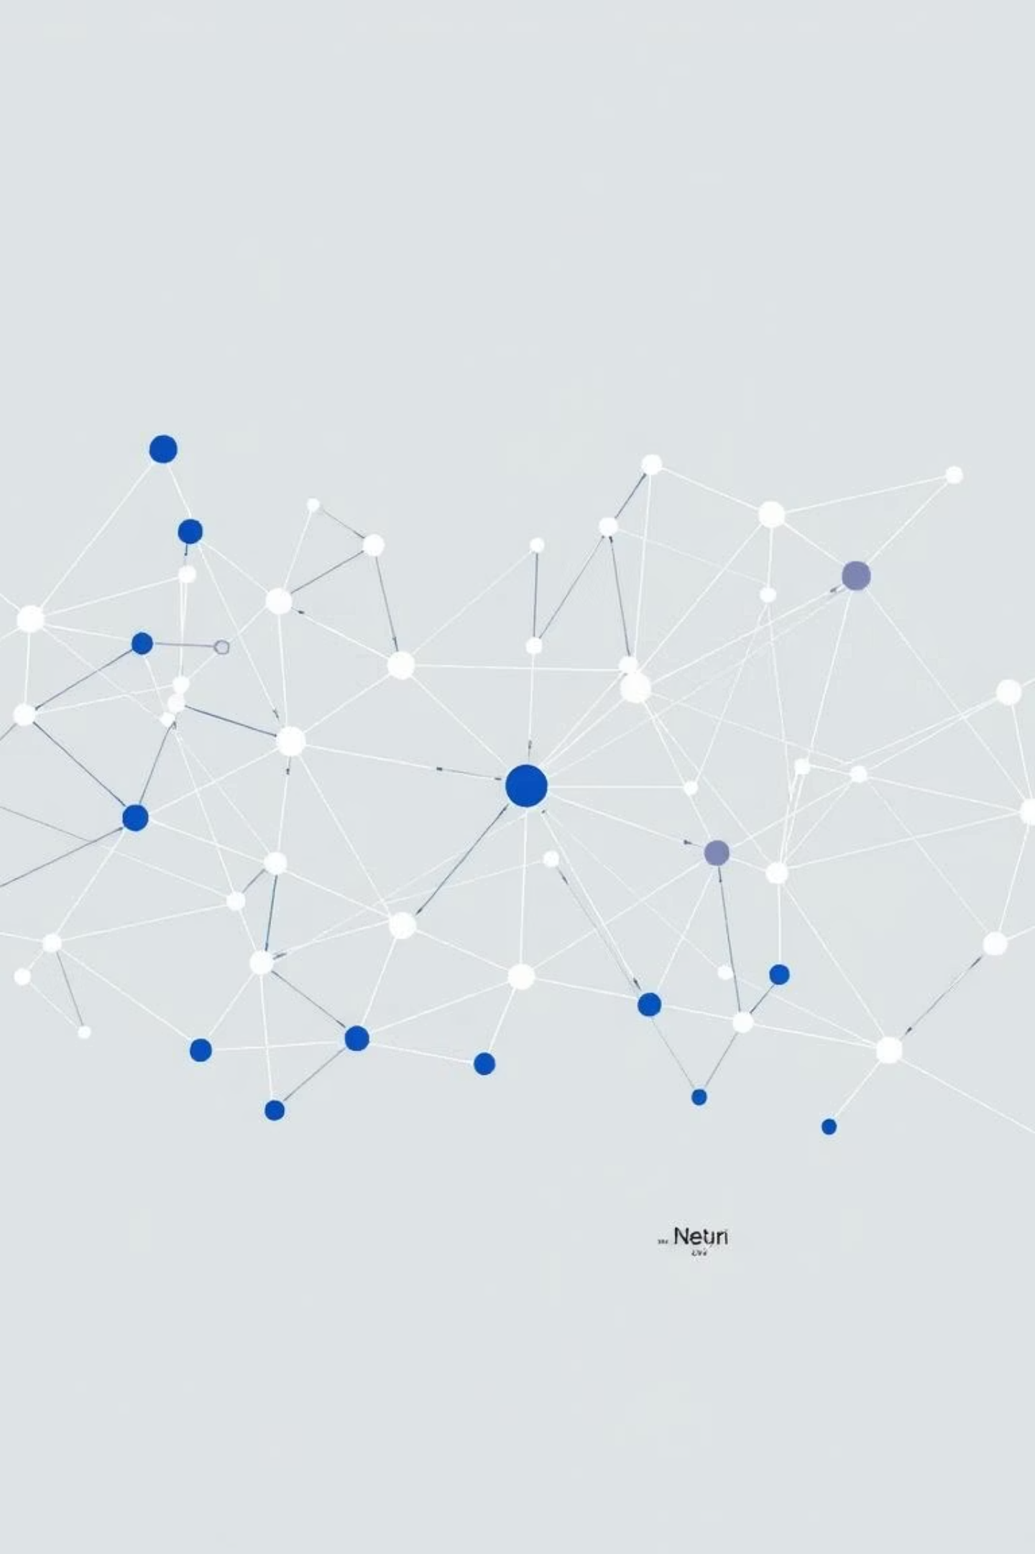
PROPOSED APPROACH
AI-Based Speech Recognition: Tailored algorithms for nuanced local languages.
Cultural Context Engine: Preserving intended meaning beyond literal translation.
Community-Driven Validation: Native speakers validate and improve datasets.
Continuous Refinement: Iterative improvement via user feedback and confidence scoring.
Real-Time Web Translation: Instantaneous audio-to-text conversion.
Scalable Infrastructure: Designed for expansion across more languages and dialects.

Slide 6
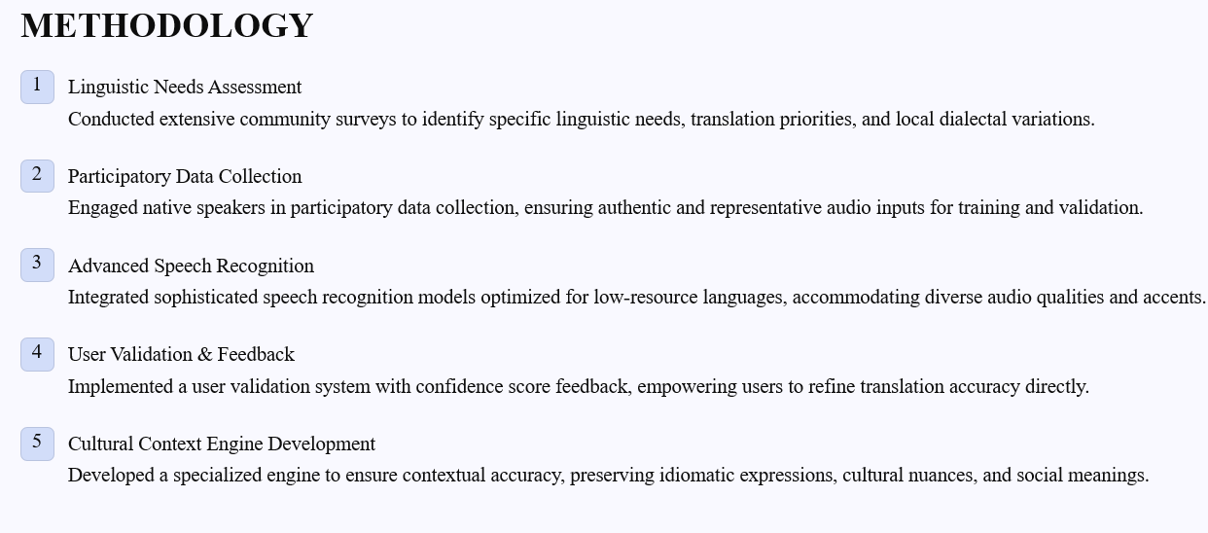

Slide 7




CONCLUSION
Bridging the Divide
Accurate & Culturally Relevant
Successfully bridges the existing language-technology divide, connecting tribal and local communities to the digital world.
Delivers highly accurate and culturally appropriate translations, ensuring meaningful and respectful communication.
Promoting Digital Inclusion
User Empowerment
Actively promotes digital inclusion and linguistic preservation, safeguarding unique cultural heritages.
Empowers marginalized users by combining cutting-edge AI with invaluable community-driven insights and tools.

Slide 8
REFERENCES
[1] Smith et al. (2021). "Low-Resource Language Speech Recognition." Proceedings of the Association for Computational Linguistics (ACL).
[2] Rao et al. (2020). "Community-Based Natural Language Processing Systems: A Participatory Approach." International Joint Conference on Natural Language Processing (IJCNLP).
[3] Singh, A. (2022). "AI for Social Good: Inclusion through Technology for Underserved Communities." IEEE Transactions on Technology and Society.
[4] Wang, K., & Bandyopadhyay, S. (2019). "Machine Translation for Low-Resource Indian Languages: Challenges and Approaches." Proceedings of the ACM Conference on Computer Supported Cooperative Work and Social Computing (CSCW).
[5] Dabre, R., et al. (2020). "Multilingual Neural Machine Translation: A Survey." ACM Computing Surveys.

